Slide 1

Computer Vision
With Python
BY Artificial intelligence club

Slide 2
Starting Requirements
Computer
Jupyter Notebook
Python and OpenCV Installed

Slide 3
Installing Opencv
Use a search query
“installing pip”
“install (***Any library**)
Look at the documentation

Slide 4
File Management
Capturing_Pics
Kunal
0
1
Srihith
1
2
2
3

Slide 5

File management (things to look out for)
What do you name your files
No spaces or special characters
Make the folder base before typing out the code
Look to see in your code if you are not overriding anything

Slide 6

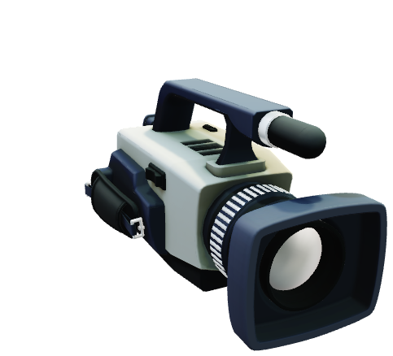
What is Open CV

Slide 7
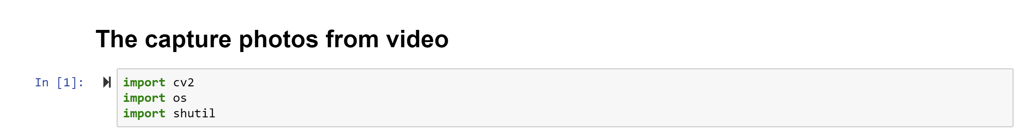
Import necessary files

Slide 8
Directory Change
https://docs.python.org/3/library/os.html
Search up os documentation python
#prints out the running directory
#os.listdir()
#who did you login from
#os.getlogin()

Slide 9
Input()
From python the input() function allows users to type in anything

Slide 10
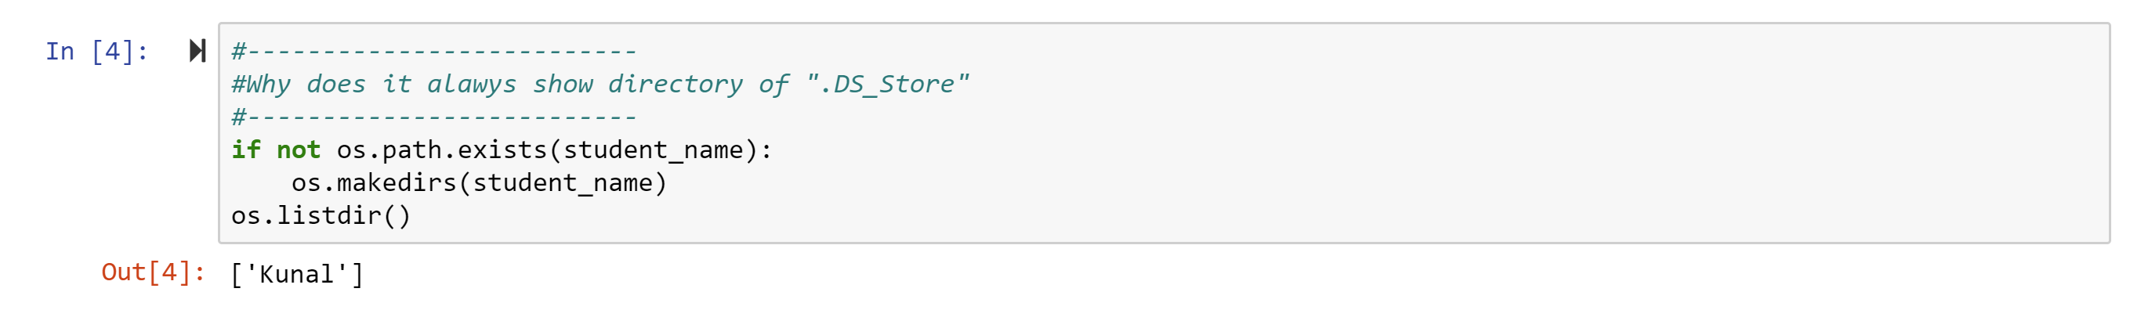
Directory and variables
Variable management

Slide 11
Directory and variables

Slide 12
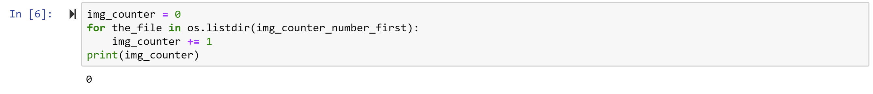
How many pics previously there

Slide 13
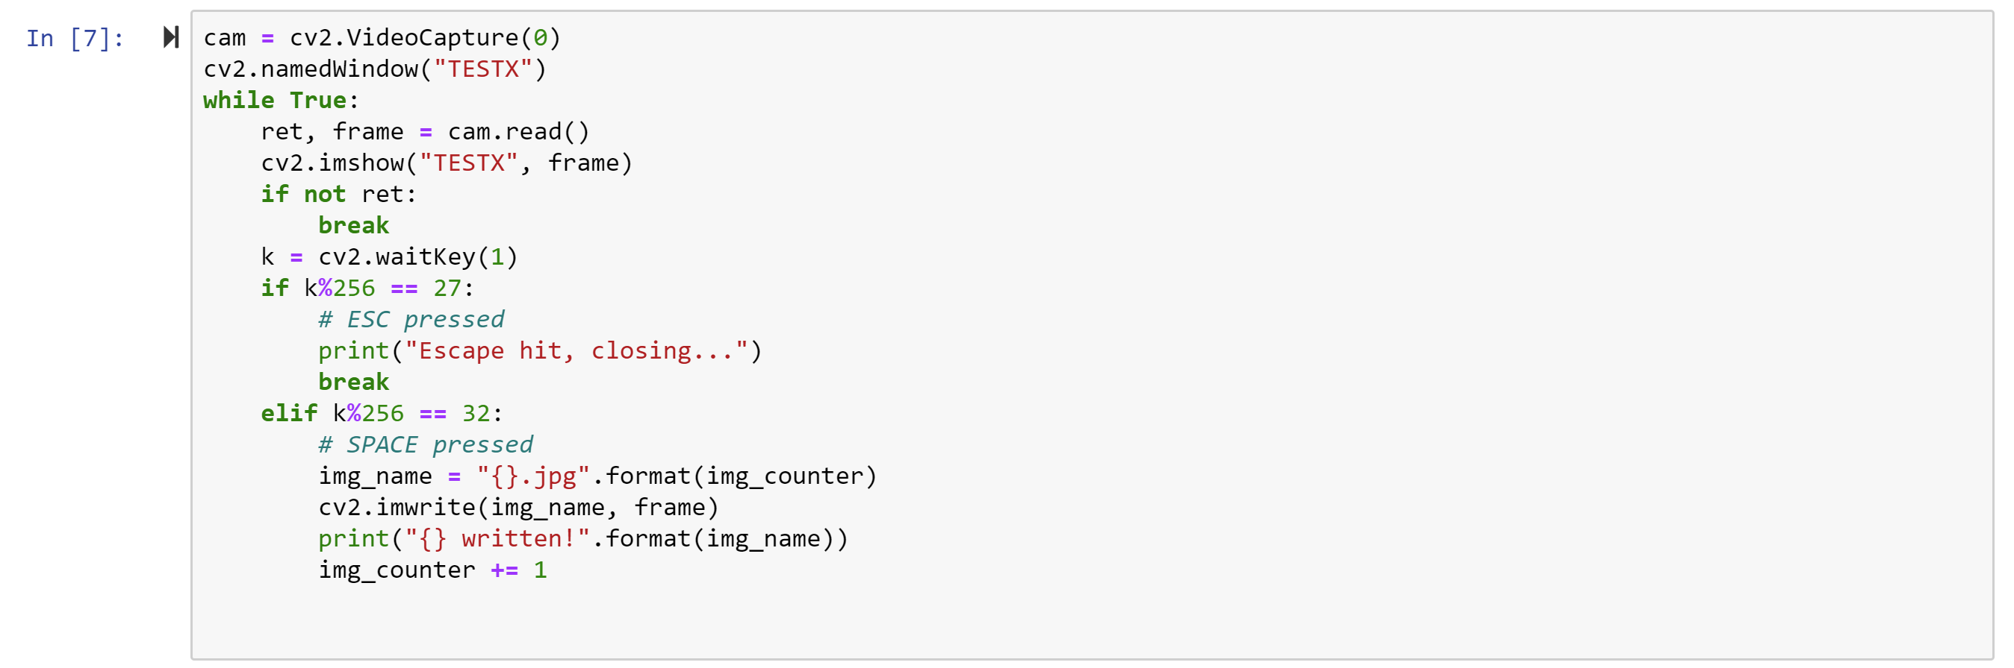
Run code

Slide 14
Quit webcam when done

Slide 15
Things to build on
Saving a video
Processing a video so it will save it
Take each frame from a video and save them
Detect a face from the previous saved picture
Any idea what you want to do
HARD

Slide 16
Use google
Most of coding is searching
Learn how to make smart search queries
Just copy the error into google
Look for inspiration in Googlr

Slide 17
Guest Speakers
Oct 28th
Dr. Mark Tabladillo
linkedin2016@marktab.com
770 365 0733
Producing Azure cloud-based AI and data science solutions at Microsoft
https://www.linkedin.com/in/marktab
Talk about demo the “intelligent kiosk” collection of AI apps from Microsoft
Demo
Demand among the AI technologies and measured by overall use
Nov 4th
Larry Lafferty
larrylafferty@veloxiti.com
Cell: 404-909-5214
President and Chief Executive Officer at Veloxiti
https://www.linkedin.com/in/larry-lafferty-59b437
Discuss the topic of “Explainable AI”. The general question we’ll discuss is “How can we build AI systems that can explain the results they produce?”
There will be 4 people from Veloxiti, and we’d like to use a panel discussion format so that we can describe 4 different approaches.
Meeting length will be 1:15

Slide 18
Our projects
Robot
Robot in shipment and we will be starting the training as soon as we get the robot
ID Scanner
We can start right now
All you need access to a web camera which you have on your computer and we have it
Cafeteria
The code is already there and shared with you
Will start in the upcoming weeks
Drone (New Idea)
Similar to spark drone and it will be controlled by hand
First hack into the drones wifi and then get access to the web camera
Detect hand/face and control the speed of different fans based on that

